Slide 1
FreeCAD failure ?
21 July 2020
Bertil Jonsson
Email: bertil.gelebo@outlook.com

Slide 2
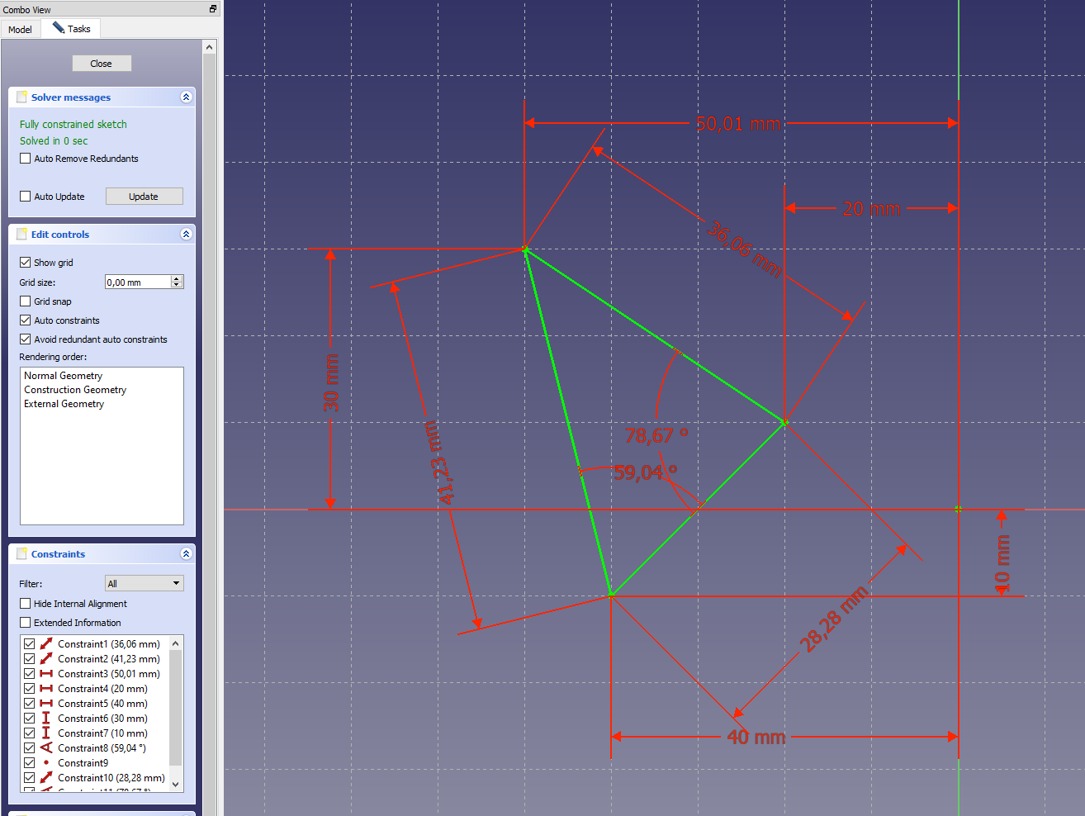
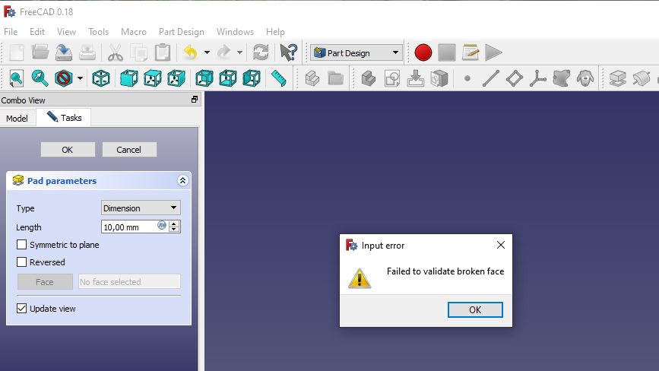
From scetch to solid did not work – why ?
I made a simple scetch for testing and got it green (fully constrained) but then, when I pressed the ”Pad”-button I got a failure message – what is wrong ?
”Failed to validate broken face…..”

